Slide 1
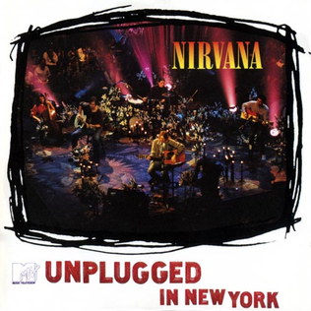
MICROPROCESSOR
PROJECT REVIEW - 1

Slide 2
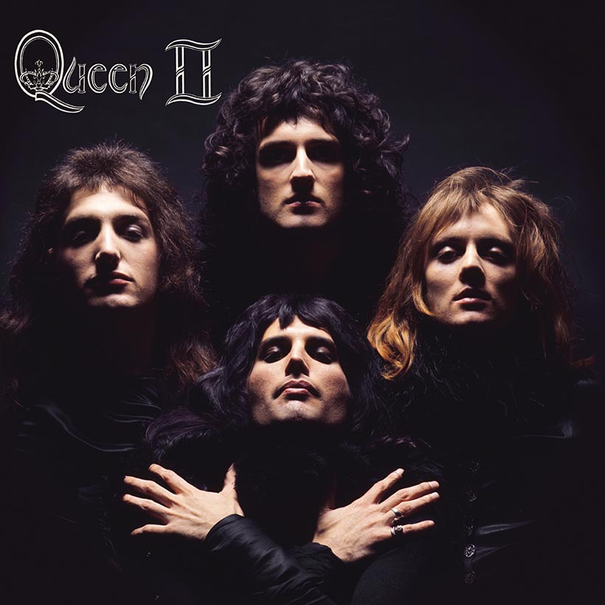
TEAM MEMBERS
ARYAMAN MISHRA – 19BCE1027
ESHAN DAS – 19BCE1575
NIMISHA SWAIN – 19BCE1860

Slide 3

ARDUINO MUSIC DEVICE

Slide 4
INTRODUCTION
It’s a fun device that plays a tune and flashes colored LED lights.
we're going to build a musical toy. Using an Arduino is going to play a familiar tune. Well, it flashes some lights, something like this. Along the way, you'll be learning a little bit about electron ICS a little bit about programming and even a bit about music
By creating an interface and a program that can call certain values to be output to an audio out, the Arduino Synthesizer is a robust tool for making a rudimentary noise machine. It uses granular synthesis techniques to generate a distinctive sound that can be a whole lot of fun for musicians, artists, tinkerers, and hobbyists.

Slide 5
ABSTRACT
Arduino Music Player
An Arduino-based device that can play MP3 files from a microSD card.
Music will be generated by the passive buzzer which would use AC voltage.It would act as an electromagnetic speaker within the device which would produce a sound due to changing the input signals.
Device can be distributed among masses as an entertainment commodity or a simple toy.
Coding would require an additional custom header file for implementing octaves and notes.

Slide 6
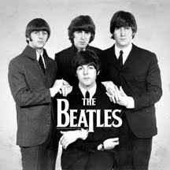
Components Required
Arduino UNO (or any Arduino Board)
SD Card Adapter / Module
microSD Card
Small Speakers
3 x Push Buttons
Breadboard
Connecting Wires

Slide 7
an Arduino uno or Arduino Uno clone.
a USB A to B cable
three LEDs
4 1/4 watt resistors value of 330 homes, although any value between
154 170 OEMs will suffice.
resistor could have a value of 10,000 ohmes, which is also referred to
as 10 key loans or simply 10-K Any resistor with a value of 5.62 22 key
loans will work.
a PS electric buzzer or speaker
a push buttons which this will be an S P S t.
Momentary contact switch
a sawed Elice bread board.
10 jumper wires.

Slide 8
Installing the Arduino IDE Software: now, in order to work with the yard, we know you're going to need a piece of software called the Hard Reno Integrated Development Environment or I D. E E. or you can also install the I. D. E on a Macintosh or on Olympics workstation.
The first step is to go to the Arduino website at Arduino dot cc. Now click the download link and from there choosier operating system.

Slide 9
Features
Play MP3 files from microSD card.
Go to next and previous songs with single press.
Increase and decrease volume level with long press.
Pause and resume the currently played song with double press.
LED that indicates when a song is played.

Slide 10
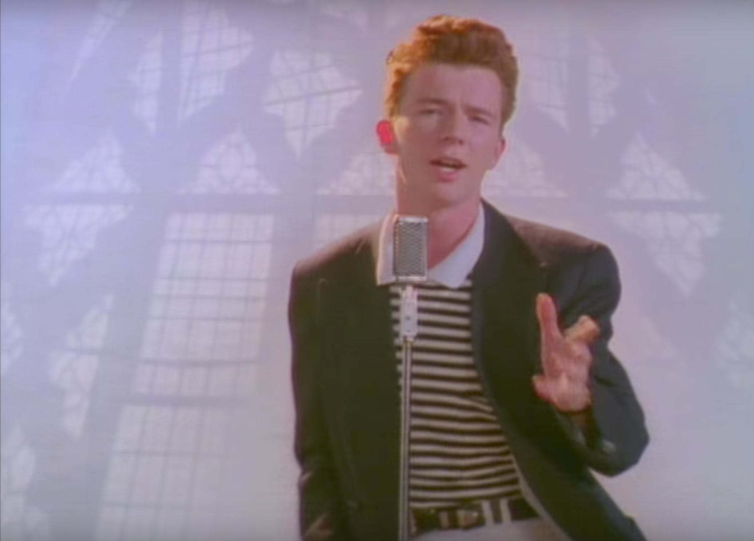
SAY GOODBYE.....

